Slide 1
AI Powered ultra summarizer and communicator
A Web application
Kartikey Singh​
GitHub Repository: https://github.com/kartikey1188/Mini-Project

Slide 2
Challenge mission
Information is scattered across multiple videos and documents, making it difficult to get a holistic understanding.
Manually summarizing multiple sources is time-consuming and inefficient.
Traditional summarizers focus on single files, lacking the ability to combine insights from multiple sources.
Users also need an interactive way to ask questions about the combined content in addition to just reading static summaries..
Unifying Knowledge: The app combines multiple videos and documents to generate a single, cohesive and holistic summary, saving time and effort.
Intelligent Interaction: Users can query the provided content (combination of YouTube videos or PDFs) for precise information rather than passively consuming summaries.
AI-Powered Efficiency: Leveraging RAG (Retrieval-Augmented Generation) with ChromaDB and LangChain, the app ensures accurate, context-aware responses.

Slide 3
SPECIFIC FUNCTIONALITIES
Generate holistic summaries combining content of multiple YouTube videos simply using their links.
Converse with the combined content matter of the YouTube Videos
Generate holistic summaries combining content of multiple PDF documents simply through uploading them on the application.
Converse with the combined content matter of the uploaded PDF Document
Have your uploaded links and PDFs saved in your personal account.
Delete any link or PDF from the account.
Download a CSV file containing all your past generated summaries.

Slide 4
Technologies used
Flask (Backend)
Vue.js (Frontend)
Flask-Security (for Authentication)
LangChain (for AI & RAG Integration)
SQLite Database
ChromaDB (Vector Database for Semantic Search & AI Queries)
Redis (for Caching)
Celery (for CSV export)
SQLAlchemy (for ORM)
Vuex (for state management)
RAG (Retrieval augmented generation)
YoutubeTranscriptAPI (to help generate transcripts of videos)

Slide 5
POTENTIAL USERS
Students & Researchers – Quickly summarize lectures, academic papers, and study materials – in various combinations.
Educators & Professors – Generate concise lecture summaries/notes and get tutored.
Professionals & Businesses – Extract key insights from company documents and query them.
Anyone Seeking Quick Information – Save time by getting AI-powered summaries of lengthy content (video or text) and talk to it.

Slide 6
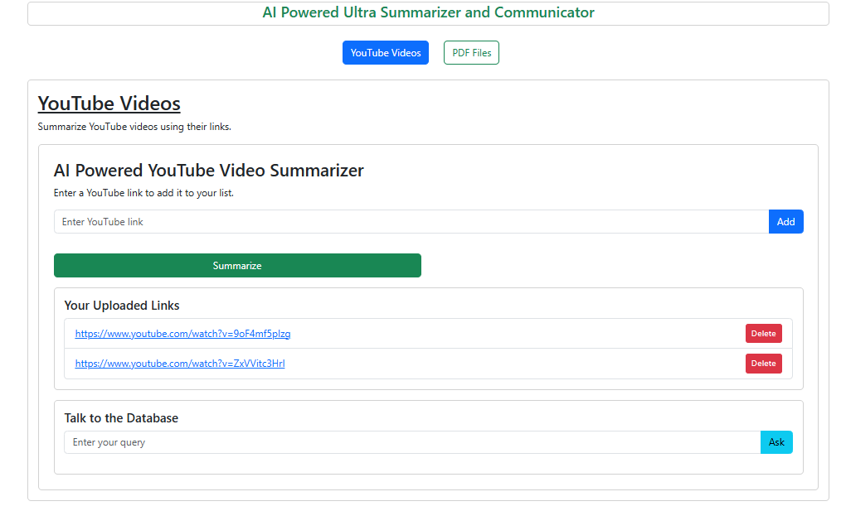
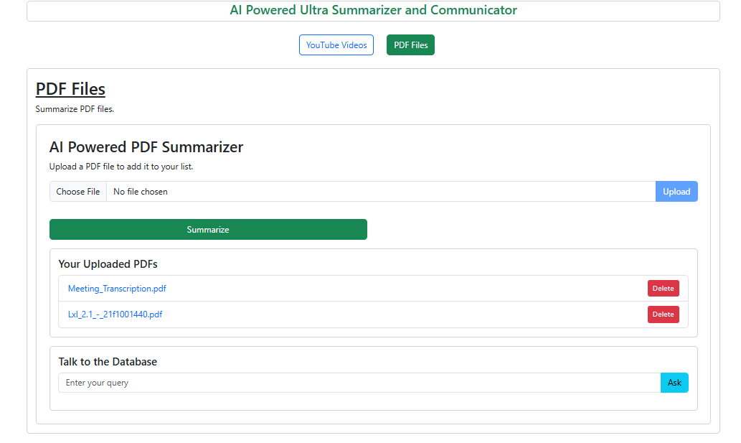
PROTOTYPE SCREENS / DEVELOPMENT STAGE UI

Slide 7
THANK YOU
Questions & SUGGESTIONS WELCOME

